Slide 1
Human Trafficking: Defining the Problems/Debunking the Myths
Abigail Layton, Esq.
Lisa A. Minutola, Esq.
Stephen T. Lawless, MD, MBA

Slide 2
What is Human Trafficking?
The use of coercion or deception of force for the purpose of placing men, women, or children in slavery or slavery-like conditions.
Human Trafficking is modern-day slavery.
Involves the exploitation of persons for commercial sex or forced labor, plus the inability to extricate oneself from that situation.

Slide 3
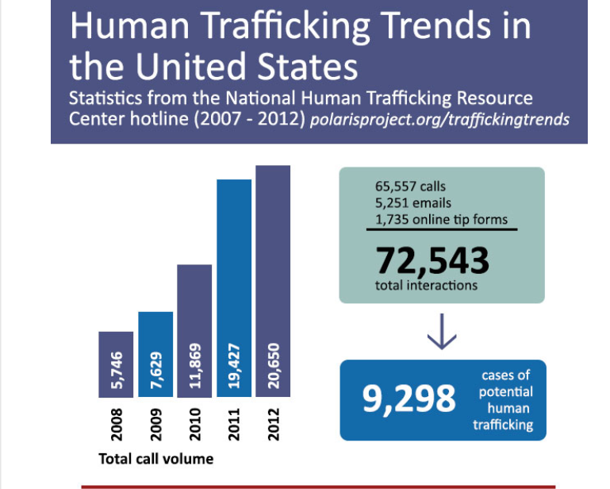

Slide 4
How People are Trafficked…
Prostitution
Exotic dancing
Agricultural work
Landscape work
Domestic work and child care (“domestic servitude”)
Factory work
Personal sexual exploitation
Begging/ street peddling
Restaurant work
Construction work
Carnival work
Hotel housekeeping
Day labor

Slide 5
Who is involved in trafficking?
Recruiter- Gains the victim’s trust and then sells for labor or to a pimp. Can be a boyfriend, neighbor, or family member.
Trafficker- Person who controls the victims. They instill fear through abuse, threats, and lies. Can be a member of the victim’s family.
Victim- Can be anyone
Consumer- Funds the “industry” by purchasing the goods and services. The consumer is often unaware that someone is suffering.

Slide 6
Smuggling vs. Trafficking
Requires illegal crossing of the U.S. border
Smugglers typically make their money once the alien has reached the U.S. border; their “business relationship” is then terminated
Can become trafficking once a person is forced to provide labor or services
An offense against a person
Involves compelled labor or service
Traffickers may use smuggling debt as a means to control victims
Traffickers maintain ongoing control over victims, even after the border is crossed

Slide 7
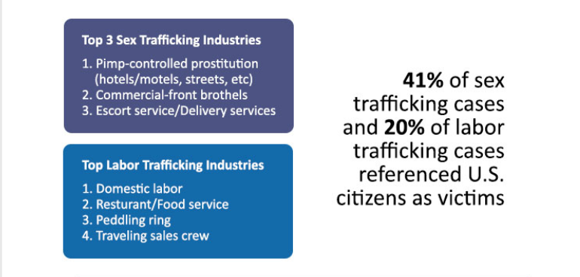
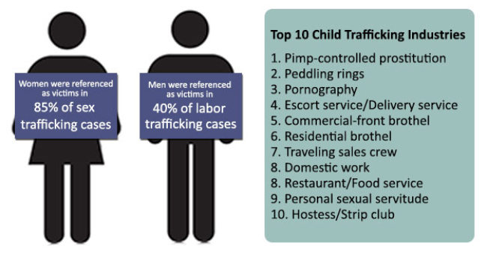
Two types of Human Trafficking exist:
Labor Trafficking
Sexual Servitude

Slide 8
Human Trafficking: What is it?
A person is guilty of trafficking an individual if the person knowingly recruits, transports, harbors, receives, provides, obtains, isolates, maintains, or entices an individual in furtherance of forced labor or sexual servitude

Slide 9
Labor Trafficking a.k.a Forced Labor
A person knowingly uses coercion to compel an individual to provide labor or services (except where permissible under state and federal laws).
Coercion:
The use or threat of force against, abduction of, serious harm to, or physical restraint of an individual
The use of a plan or statement with intent to cause an individual to believe that failure to perform will result in the abduction of, serious harm to, or physical restraint of an individual

Slide 10
Labor Trafficking a.k.a Forced Labor
Coercion (Cont’d):
The abuse or threatened abuse of law or legal process;
Controlling or threatening to control an individual’s access to a controlled substance;
The destruction of, taking of, or the threat to destroy or take an individual’s identification document or other property;
Use of debt bondage
Use of an individual’s physical, cognitive disability or mental impairment, where such impairment has substantial adverse effects on the individual’s cognitive or volitional functions
The commission of civil or criminal fraud.

Slide 11
Labor Trafficking
Victims of human trafficking in domestic work commonly work 10 to 16 hours a day or more for little to no pay.
Victims of labor trafficking of domestic workers in the U.S. are most often foreign national women living in the home of their employer.
Businesses using trafficking victims in the workforce increase the health and safety risks to consumers because most coerced laborers are not protected by state or federal work place requirements. They are often not able or encouraged to obtain needed training, certificates, licenses or registrations and thus are not subject to proper regulation designed to protect consumers regarding health and safety risks.

Slide 12
Signs of Labor Camps and Sweatshops
Security onsite to keep victims confined to the premises
Barbed wire
Bars on the windows, blacked out windows
Security cameras
High walls
Self-contained camps
Bouncers, guards, and/ or guard dogs to prevent escapes and visitors.
They are only allowed to shop at the company store

Slide 13
Sexual Servitude
A person commits the offense of sexual servitude if the person knowingly:
Maintains or makes available a minor for the purpose of engaging the minor in commercial sexual activity
Uses coercion or deception to compel an adult to engage in commercial sexual activity.
Commercial sexual activity:
Any sexual activity for which anything of value is given, promised to, or received by another person.

Slide 14
Patronizing a Victim of Sexual Servitude
If the person knowingly gives, agrees to give, or offers to give anything of value so that the person may engage in commercial sexual activity with another person and that person knows that the other is a victim of sexual servitude.
Class D Felony unless the act involves a minor which elevates it to a Class C.

Slide 15
Aggravating Circumstances
The person recruited, enticed, or obtained the victim from a shelter designed to serve victims of human trafficking, victims of domestic violence, victims of sexual assault, runaway youth, foster children or the homeless; or
The person used or threatened the use of force against, abduction of, serious harm to or physical restraint of the victim.

Slide 16
Sexual Servitude
Industries that could facilitate sex trafficking:
Massage parlors
Escort services
Adult bookstores
Modeling studios
Bars/ strip clubs

Slide 17
Brothels
Large amounts of cash and condoms
Customer logbooks- one for the house and one for the victims
Sparse rooms
Men come and go frequently
Used twin mattresses stacked up outside of the residence

Slide 18
Signs of Sexual Servitude
Malnutrition, dehydration or poor personal hygiene
Sexually transmitted diseases
Signs of rape or sexual abuse
Bruising, broken bones, or other signs of untreated medical problems
Critical illnesses including diabetes, cancer or heart disease; and Post-traumatic stress or psychological disorders
A chaperone or translator at all medical appointments- this could be the trafficker acting as a “friend”
Tattoos or branding

Slide 19
The Trafficked Person
Who is a victim?
A victim can be any person, regardless of their citizenship status, country of origin, or sex.
Certain populations are especially vulnerable: undocumented immigrants; runaway and homeless youth; victims of trauma and abuse; refugees and individuals fleeing conflict; and oppressed, marginalized, and/or impoverished groups and individuals.
Runaways and at-risk youth are targeted by pimps and traffickers for exploitation in the commercial sex industry or different labor or services industries. Pimps and sex traffickers are skilled at manipulating child victims and maintaining control through a combination of deception, lies, feigned affection, threats, and violence.

Slide 20
The “Invisible” Victim
Many are illegal and fear the U.S. authorities
Victims may be physically isolated or guarded; others are help through psychological coercion
Many victims do not speak English
Many have no idea where they are in the U.S. and face tremendous cultural barriers
Many do not realize that they are victims or that they have rights under U.S. laws

Slide 21
Victim Vulnerabilities
Why don’t they just escape?
Means to control the victims…
The traffickers have a strong psychological and physiological hold on them.
Fear of deportation.
Dangers of leaving without money or a place to go; they do not have a way to support themselves and their children if they have any.
Fear for the safety of their families in their home countries.
Human Trafficking reaches every culture and demographic. Regardless of that, all victims are vulnerable in some way, and the trafficker will exploit those vulnerabilities.
Beatings, burnings, rapes and starvation are used as punishment
Isolation as a punishment
Drug or alcohol dependency
Document withholding
Debt bondage
Threats of deportation

Slide 22
Signs of Trafficking: If the individual…
Is not free to leave or come and go as he/she wishes
Is unpaid, paid very little, or paid only through tips
Works excessively long and/or unusual hours
Is not allowed breaks or suffers under unusual restrictions at work
Is fearful, anxious, depressed, submissive, tense, or nervous/paranoid
Exhibits unusually fearful or anxious behavior after bringing up law enforcement
Avoids eye contact
Loss of sense of time
Has few or no personal possessions
Is not in control of his/her own money, no financial records, or bank account
Is not in control of his/her own identification documents (ID or passport)
Is not allowed or able to speak for themselves (a third party may insist on being present and/or translating)
Claims of just visiting and inability to clarify where he/she is staying/address
Lack of knowledge of whereabouts and/or do not know what city he/she is in
Has numerous inconsistencies in his/her story

Slide 23
Victim Living and Working Conditions
Live on or near work premises
Restricted or controlled communication
Frequently moved by the traffickers
Large number of occupants in one living space

Slide 24
Personal and Physical indicators
Injuries from beatings or weapons
Signs of torture- for example cigarette burns on the skin
Brands or scarring to indicate ownership
Signs of malnourishment

Slide 25
Victims May Lack…
Personal items or possessions
Cell phone, calling card, or other means to communicate to the outside world
Private space or their own room
Financial records and even their own money
Knowledge of the place they live or how to get around the community
Friends or relationships with people outside their immediate circle
The freedom to come and go as they please

Slide 26
Victim Issues
They may not identify themselves as victims
May not speak English
They are likely to lie or use rehearsed stories at initial contact
May be behaviorally dependent on the trafficker
They may be reluctant to speak to someone who is wearing a badge, gun, or uniform
They may be culturally conditioned to fear law enforcement

Slide 27
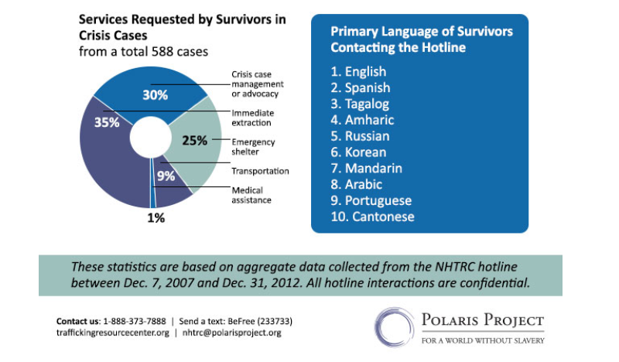

Slide 28
Myths and Misconceptions
Information courtesy of PolarisProject.com

Slide 29
Myth 1: Under the federal definition, trafficked persons can only be foreign nationals or are only immigrants from other countries.
Reality: The federal definition of human trafficking includes both U.S. citizens and foreign nationals - both are protected under the federal trafficking statutes and have been since the TVPA of 2000. Human trafficking encompasses both transnational trafficking that crosses borders and domestic or internal trafficking that occurs within a country. Statistics on the scope of trafficking in the U.S. are most thorough and accurate if they include both transnational and internal trafficking of U.S. citizens as well as foreign nationals.
Myth 2: Human trafficking is essentially a crime that must involve some form of travel, transportation, or movement across state or national borders.
Reality: The legal definition of trafficking, as defined under the federal trafficking statutes, does not require transportation. Although transportation may be involved as a control mechanism to keep victims in unfamiliar places, it is not a required element of the trafficking definition. Human trafficking is not synonymous with forced migration or smuggling. Instead, human trafficking is more accurately characterized as exploitation, a form of involuntary servitude, or “compelled service” where an individual’s will is overborne through force, fraud, or coercion.
Myth 4: There must be elements of physical restraint, physical force, or physical bondage when identifying a human trafficking situation.
Reality: The legal definition of trafficking does not require physical restraint, bodily harm, or physical force. Psychological means of control, such as threats, fraud, or abuse of the legal process, are sufficient elements of the crime. Unlike the previous federal involuntary servitude statutes (U.S.C. 1584), the new federal crimes created by the Trafficking Victims Protection Act (TVPA) of 2000 were intended to address “subtler” forms of coercion and to broaden previous standards that only considered bodily harm. It is important for definitions of human trafficking in the U.S. and around the world to include a wide spectrum of forms of coercion in order for the definition to encompass all the ways that traffickers control victims.
Myth 3: Human trafficking is another term for human smuggling.
Reality: There are many fundamental differences between the crimes of human trafficking and human smuggling. Both are entirely separate federal crimes in the United States. Most notably, smuggling is a crime against a country’s borders, whereas human trafficking is a crime against a person. Also, while smuggling requires illegal border crossing, human trafficking involves commercial sex acts or labor or services that are induced through force, fraud, or coercion, regardless of whether or not transportation occurs.

Slide 30
Questions to Ask…
Can you leave your job if you want to?
Can you come and go as you please?
Have you been hurt or threatened if you tried to leave?
Has your family been threatened?
Do you live with your employer?
Where do you sleep and eat?
Are you in debt to your employer?
Do you have your passport/identification? Who has it?

Slide 31
Recent Legislation
HB 197 w/SA 2 - 2014
Strengthened the definition of “coercion”
Expanded the definition of “sexually explicit performance” to include production of pornography and its transfer
Sharpened the definitions of “trafficking,” “forced labor,’ and “sexual servitude”
Focused on the demand side by imposing heightened penalties on those who patronize victims and businesses
Additional penalties if you find victims at shelters, foster homes, etc.
Restitution is ordered even if the victim is not present to accept payment

Slide 32
Recent Legislation
Protections
Forfeiture of property used to commit human trafficking
Prohibiting the introduction of the victim’s sexual past, with limited exceptions
Creating a “safe harbor” for minors engaged in commercial sex trafficking
Affirmative defense for victims charged with prostitution or loitering
Victims may sue traffickers for damages
Victims may apply for a pardon, request expungement, or file a motion to vacate convictions for crimes committed as a result of being a HT victim

Slide 33
Recent Legislation
Prevention
Creating a Human Trafficking Coordinating Council (HTCC) charged with developing a comprehensive state plan, evaluating data, promoting public awareness
Requiring that public awareness signs be posted in specific locations
Ensuring that human trafficking victims are eligible for services
Assisting victims who may be eligible for specified visa status

Slide 34
HTCC
Established - March 12, 2015 - https://egov.delaware.gov/pmc/#agency242
HTCC has been created to develop a comprehensive anti-human-trafficking plan, evaluate data, effectuate interagency cooperation, and other important tasks
DOJ, Courts, Law Enforcement, ODS, Service Providers, DHSS, DSCFY
Activities
Trainings: Statewide Conference planned November 21 – Dover Downs
Bench Card, Screen Tools
Victim Services

Slide 35
HTCC: Subcommittees
Victim Services
Outreach, Public Awareness and Training
Legislative Drafting and Review, Strategic Planning and Task Force Protocol
Law Enforcement
Juveniles

Slide 36
Defendants May Be Victims Too
Human Trafficking Victims as Criminal Defendants - Bench Card created by the Center for Public Policy Studies, the Human Trafficking and State Courts Collaborative and the State Justice Institute
HTCC Juvenile Subcommittee is developing Delaware Bench Card and Screening Tools
Real Delaware case examples

Slide 37
Defendants May Be Victims Too: Common Crimes
Common Crimes that Victims are Forced to Commit
Prostitution
Drug Dealing
Theft
Peddling
Solicitation

Slide 38
Defendants May Be Victims Too: Other Crimes
Other Crimes/Legal Proceedings Associated with Defendants who are Trafficking Victims
Gang Activity
Drug Use
Code Violations
Delinquency/Status Offenses for Juveniles
Child Abuse and Neglect
Guardianship

Slide 39
Defendants May Be Victims Too: Evidence
Threats or physical/non physical harm used to compel victim
Threats of use of law to compel victim
Demeaning or demoralizing the victim
Disorienting or depriving the victim
Diminishing resistance and debilitating the victim
Deceiving victim about consequences
Dominating, intimidating and controlling the victim
May be used by evidence by either prosecution or defense

Slide 40
Defendants May Be Victims Too: Defenses
§ 431 Duress as affirmative defense; defense unavailable in certain situations.
(a) In any prosecution for an offense, it is an affirmative defense that the defendant engaged in the conduct charged to constitute the offense because the defendant was coerced to do so by the use of, or a threat to use, force against the defendant's person or the person of another, which a reasonable person in the defendant's situation would have been unable to resist.
(b) The defense provided by subsection (a) of this section is unavailable if the defendant intentionally or recklessly placed himself or herself in a situation in which it was probable that the defendant would be subjected to duress.
Coercion may negate criminal intent
Coercion may be used as mitigation

Slide 41
Defendants May Be Victims Too: Options
Defense may provide evidence that defendant is victim
Persuade DOJ to drop case
Negate intent
Defense of coercion
Mitigation
Court may refuse to accept guilty plea if defendant may actually be victim
Send defendant to treatment programs or problem solving court
Continue case to gather additional evidence on victimization

Slide 42
Awareness is occurring
American Academy of Pediatrics (AAP)
American College of Emergency Physicians
The American College of Obstetricians and Gynecologists (ACOG)
American Medical Association (AMA)
American Medical Women’s Association (AMWA)
American Nurses Association (ANA)
American Psychological Association (APA)
Emergency Nurses Association
New York State Nurse’s Association

Slide 43
Condition/Environment
Impacts on Health & Healthcare

Slide 44
Gross Findings
Sexual assault
Physical Injury
Substance abuse/overdose issues
Reproductive concerns
Psychological

Slide 45
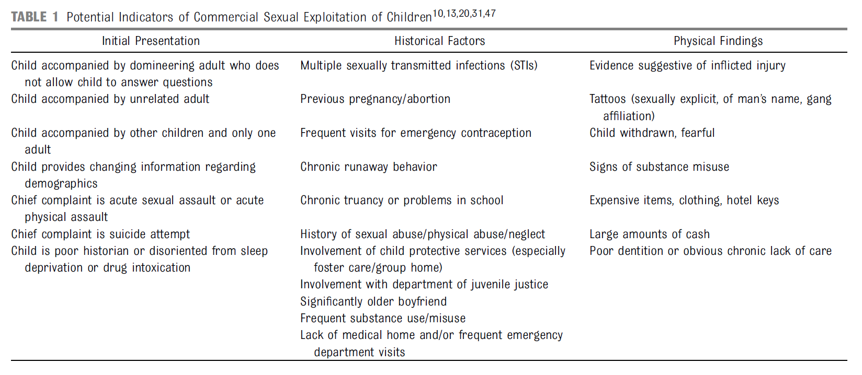
PEDIATRICS Volume 135, number 3, March 2015

Slide 46
Clues
Sexually transmitted diseases
Pregnancy
Infertility
Infections or mutilations
Chronic back, hearing, cardiovascular or respiratory problems
Weak eyes
Malnourishment and serious dental problems
Tuberculosis
Undetected or untreated diseases
Bruises in areas that won’t damage their outward appearance
Substance abuse problems
Psychological trauma: depression, stress related disorders, phobias and panic attacks
Feelings of helplessness
Cultural shock

Slide 47
911 Emergency
1-888-3737-888 National Human Trafficking Resource Center
For urgent situations, notify local law enforcement immediately by calling 911. You may also want to alert the National Human Trafficking Resource Center described below so that they can ensure response by law enforcement officials knowledgeable about human trafficking.
Call the National Human Trafficking Resource Center, a national 24-hour, toll-free, multilingual anti-trafficking hotline. Call 1-888-3737-888 to report a tip; connect with anti-trafficking services in your area; or request training and technical assistance, general information, or specific anti-trafficking resources. The Center is equipped to handle calls from all regions of the United States from a wide range of callers including, but not limited to: potential trafficking victims, community members, law enforcement, medical professionals, legal professionals, service providers, researchers, students, and policymakers.
1-888-428-7581 U.S. Department of Justice Worker Exploitation Complaint Line
Call the U.S. Department of Justice’s dedicated human trafficking toll-free complaint line at 1-888-428-7581 (weekdays 9 AM - 5 PM EST) to report suspected instances of human trafficking or worker exploitation or contact the FBI field office nearest you .This call is toll-free and offers foreign language translation services in most languages as well as TTY. After business hours, the complaint line has a message service in English, Spanish, Russian, and Mandarin.

Slide 48
Information Sources
www.PolarisProject.org
http://SharedHope.org
www.nij.gov
www.ovcttac.gov
www.bja.gov
http://www.htcourts.org/wp-content/uploads/HT_Victims_asCriminalDefendants_v01.pdf?InformationCard=HT-Victims-as-Criminal-Defendants
www.state.gov/j/tip/id/help/index.htm

